Slide 1






Deep Learning Flower Identification Project
Prepared By,
Vrinda Patel
Lindsay McCulloch
Yashada Kulkarni
Sri Penumatcha

Slide 2
Background Flowers are a diverse and attractive feature of plants but recognizing their species can be challenging due to their wide variety. With approximately 400,000 flowering plant species worldwide, robust identification methods are essential. Our mission is to create an efficient and robust flower classifier using deep learning techniques. By leveraging convolutional neural networks (CNNs), we aim to accurately identify different types of flowers based on their shape and colour.

Slide 3
Methodology
Data Collection: We’ve gathered a dataset of flower images, including various species, each labeled with the correct flower name from Kaggle.
Model Training: Using CNNs, we have trained our model on this dataset to learn features that distinguish different flowers.
Our trained model can accurately identify over 5 different types of flowers.
Rose
Sunflower
Dandelion
Tulip
Daisy

Slide 4



Technologies Used
Python
Pandas
NumPy
Matplotlib
Seaborn
Scikit-learn (sklearn)
Keras
Theano and TensorFlow: These are deep learning frameworks. Theano allows quick numerical calculations.
The RMSprop optimizer is a popular choice for training neural networks, especially in deep learning tasks. It stands for “Root Mean Square Propagation” and adapts the learning rate during training to improve convergence.

Slide 5


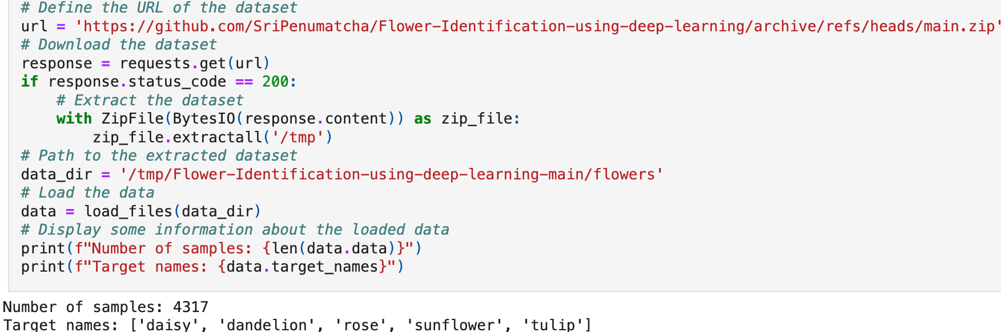
Dataset Download and Extraction
Dataset URL and Download:
- The variable url is assigned the value of a GitHub URL: GitHub Repository.
- The code uses the requests.get() method to download the dataset from this URL.
- If the HTTP status code is 200 (indicating a successful download), the dataset is extracted.
Dataset Extraction and Location:
- The dataset is extracted using ZipFile and saved to the /tmp directory.
Data Loading and Information:
- The load_files() function is used to load the data from the specified directory.
- The code prints two pieces of information:
The total number of samples in the dataset (which is 4317).
The target names (categories) within the dataset, including ‘daisy’, ‘dandelion’, ‘rose’, ‘sunflower’, and ‘tulip’.

Slide 6
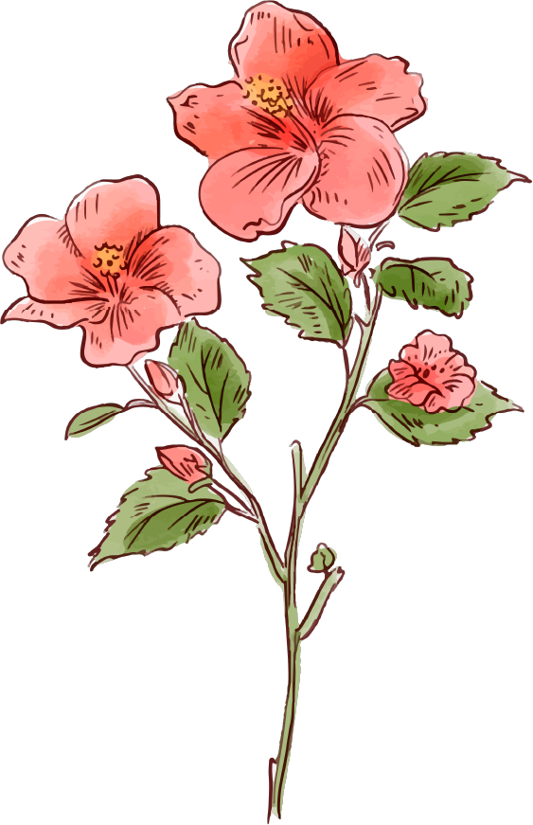
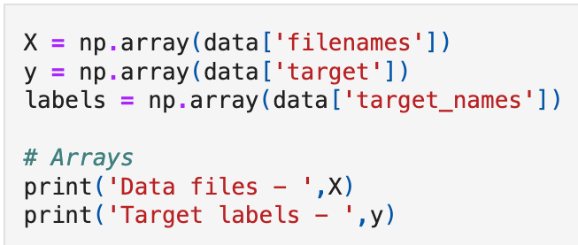
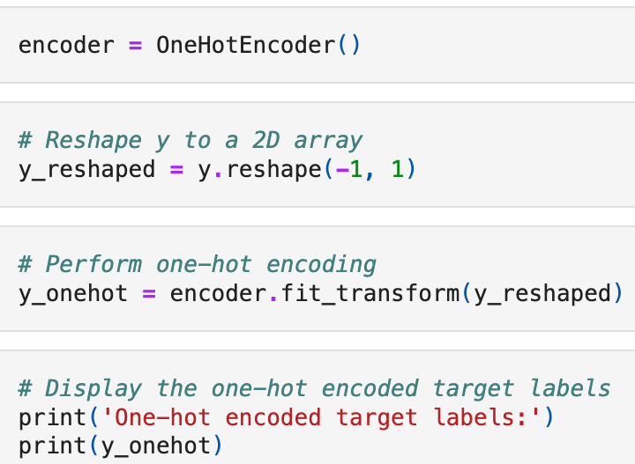
Data Processing and Exploring
Data Files (X): An array X containing data filenames.
Target Labels (y): Defined an array y for target labels.
One-Hot Encoding: One-hot encoding is a technique used to represent categorical data numerically. Here We’ve applied one-hot encoding to the target labels (y).
Here’s how it works:
First, we’ve reshaped y into a 2D array (y_reshaped) to prepare it for one-hot encoding.
Next, we’ve used the OneHotEncoder to transform the categorical labels into binary vectors. Each category becomes a separate column, and the presence of a category is indicated by a 1 in that column.
The resulting one-hot encoded labels are stored in the array y_onehot.

Slide 7
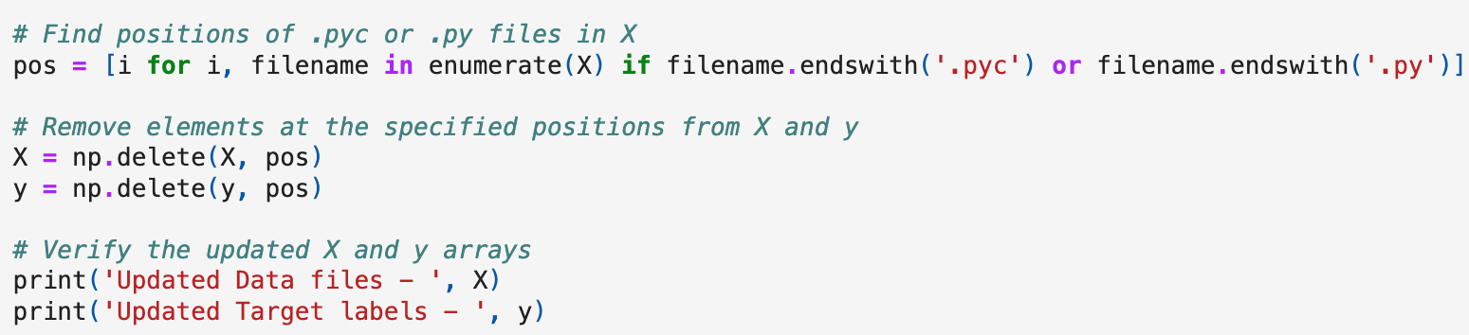
Data Processing and Exploring
Finding Positions of .pyc or .py Files in X:
The list comprehension pos is created to find the indices of elements in the array X where the filenames end with either .pyc or .py.
For each filename in X, the condition filename.endswith('.pyc') or filename.endswith('.py') checks if the filename matches either of these extensions.
Removing Elements from X and y:
We’ve used NumPy’s np.delete() function to remove elements from arrays ensuring that files with .pyc or .py extensions are excluded from further processing.
Verification:
To verify the update, we’ve printed the updated X (data files) and y (target labels) arrays.

Slide 8


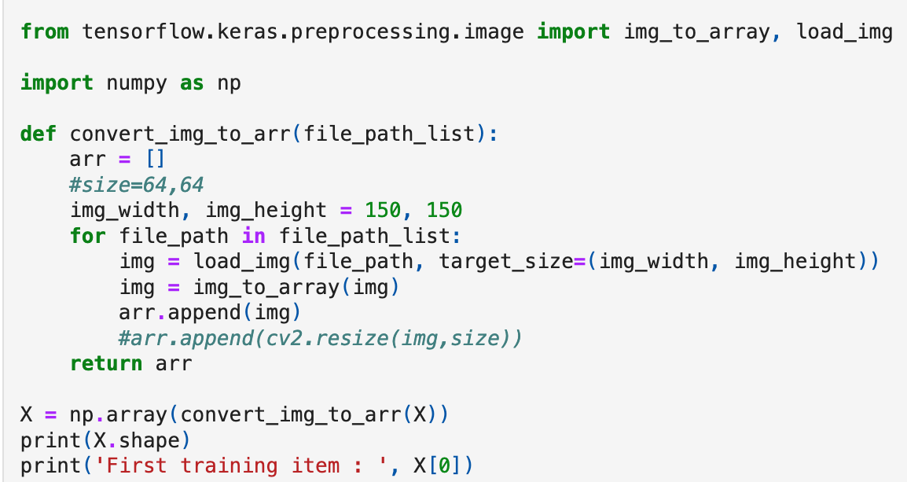
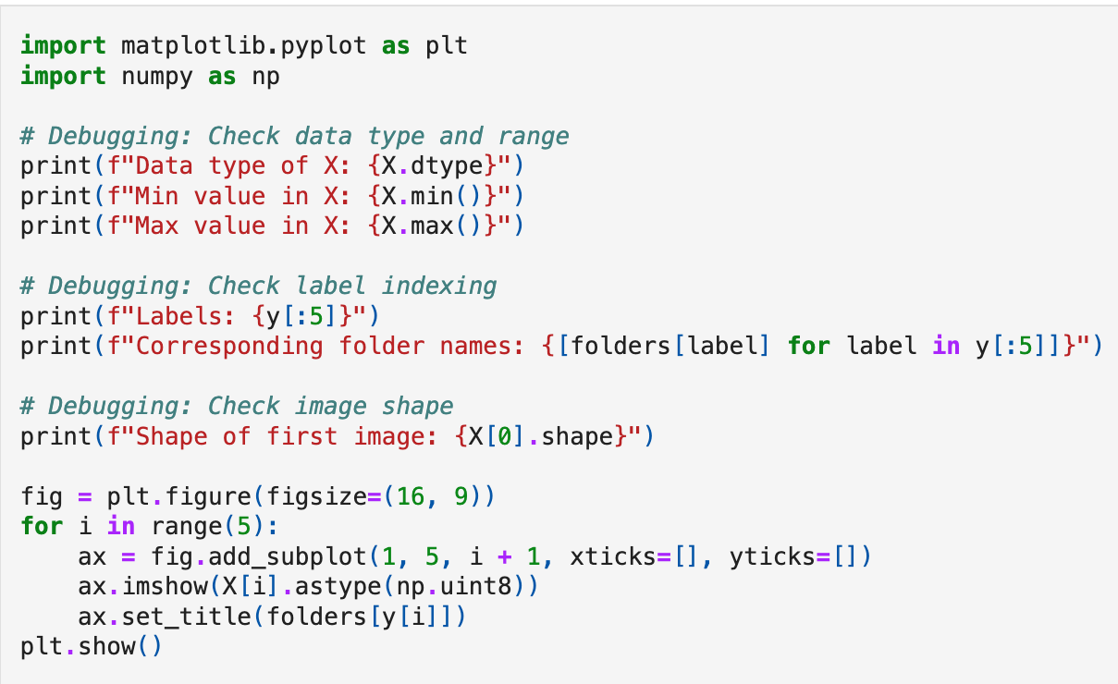
Data Processing and Exploring
The code converts images to arrays using TensorFlow’s img to_array and load_img functions.
Input: A list of file paths containing images.
Output: An array X containing the converted image data.
The shape of training data we received as (4317, 150, 150, 3)
4317 is the number of training items or files
(150,150) is the target size or image size provided while loading image
3 refers to the depth for colored images ( RGB channels )
- Data Type and Range for checking the data type of X (which should be an array of image data) and the minimum and maximum values within that array.
- Label Indexing printing the first five labels to verify their correctness.
- Image Shape for creating a 1x5 grid of subplots to visualize the first five images.
Notes:
Objective: The code converts images to arrays using TensorFlow’s img_to_array and load_img functions.
Input: A list of file paths containing images.
Output: An array X containing the converted image data.
Key Points:
The shape of training data is (4317, 150, 150, 3)
4317 is the number of training items or files
(150,150) is the target size or image size provided while loading image
3 refers to the depth for colored images ( RGB channels )
Data Type and Range: You’re checking the data type of X (which should be an array of image data) and the minimum and maximum values within that array. This helps ensure consistency and proper handling of the data.
Label Indexing: You’re printing the first five labels (presumably corresponding to image categories or classes) and their corresponding folder names. This is useful for verifying that your labels are correctly indexed.
Image Shape: You’re checking the shape of the first image in X. This confirms the dimensions (height, width, and channels) of your image data.
Display Images: Finally, you’re creating a 1x5 grid of subplots to display the first five images from X, along with their corresponding labels.

Slide 9

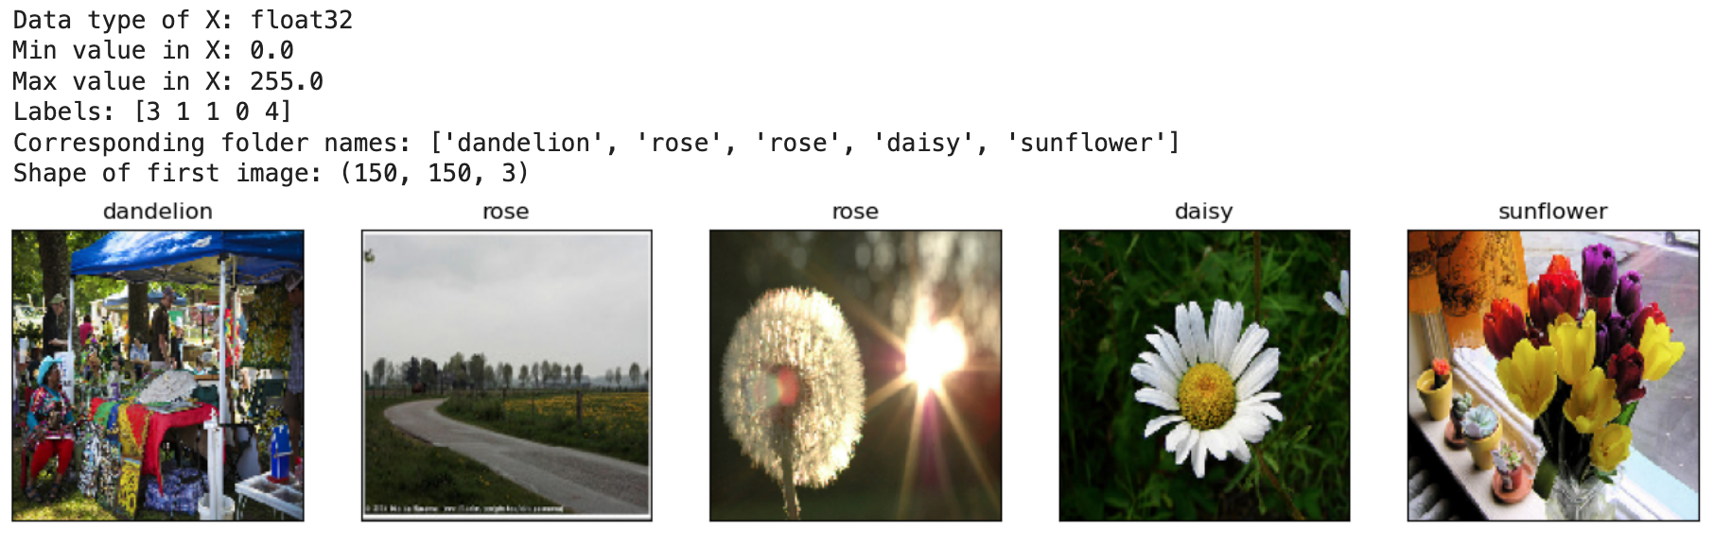
Some Beautiful Flower Images (Sample Data)
Each subplot displays an image from X (converted to uint8 for display) along with its corresponding label.

Slide 10

Training, Testing and
Comparing our 4 CNN models

Slide 11
Slightly different methods across our models
For Importing Data
files stored locally, loaded using Python os module
from GitHub repo, using requests.get(), storing them as temp files, using os
Data Preprocessing
using data pipelines (image_dataset_from_directory)
manually creating arrays

Slide 12
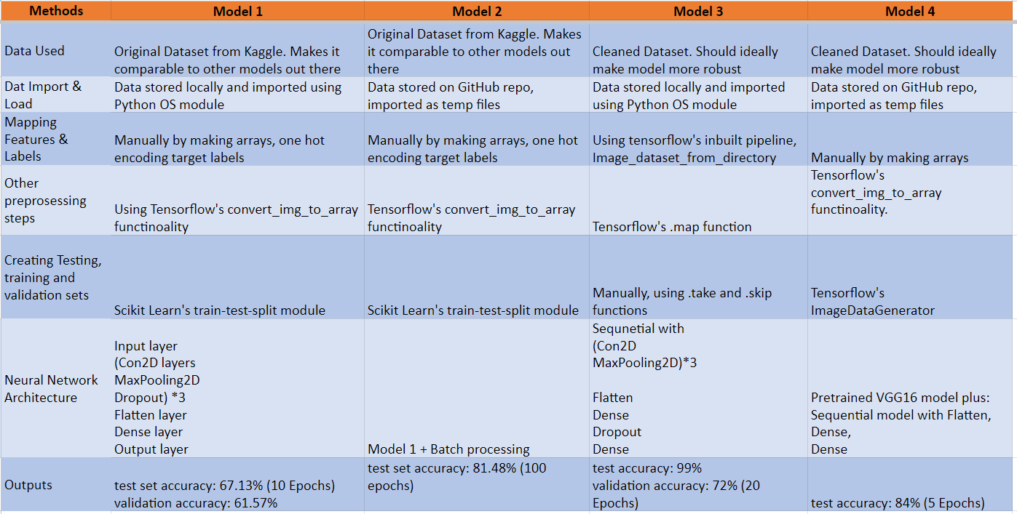
Overview of our models

Slide 13
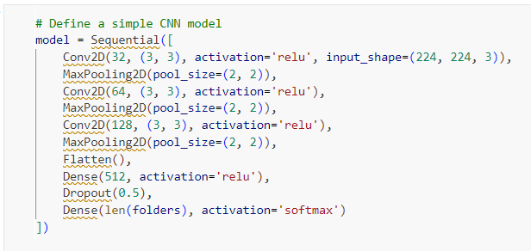
Flower Identification Model 1
Accuracy: 67%
Architecture:
Used basic CNN architecture with Conv2D, MaxPooling2D, and Dense layers.
No advanced techniques like Batch Normalization or data augmentation.
Optimization: Initially used Adam optimizer and later switched to RMSprop.
Training: Trained for 10 epochs with a batch size of 32.

Slide 14
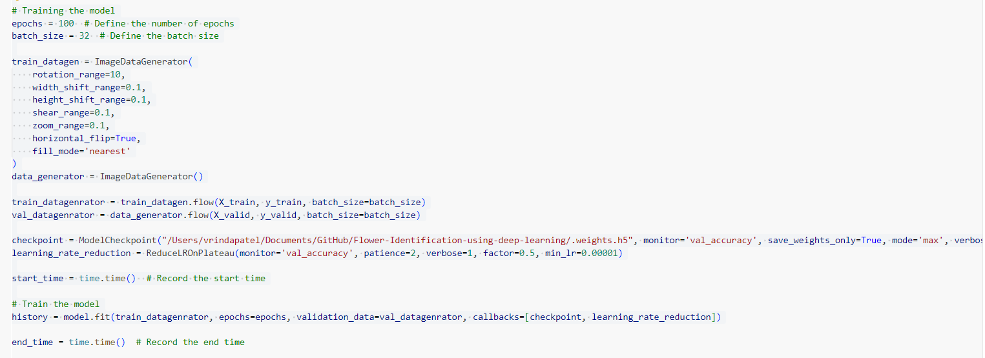
Flower Identification Model 2
Accuracy: 81%
Architecture:
Implemented Batch Normalization, data augmentation, and optimized training strategies.
Used RMSprop optimizer with specified parameters.
Training: Trained for 100 epochs with batch size 32 and data augmentation.

Slide 15
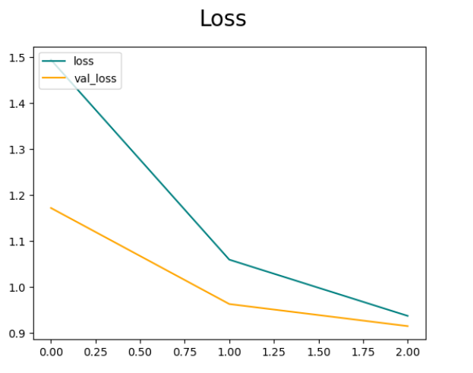
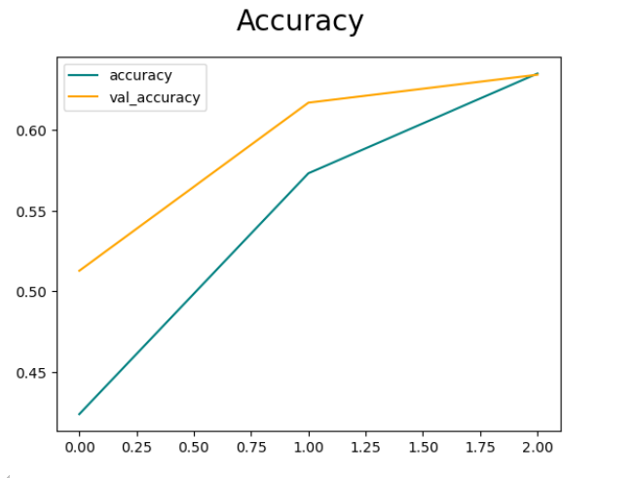
Flower Identification Model 3
Accuracy: 72%
Architecture:
Utilized TensorFlow Dataset API for data processing.
Implemented a simple CNN model with Conv2D, MaxPooling2D, and Dense layers.
Training: Trained for 20 epochs with monitoring of validation accuracy.

Slide 16
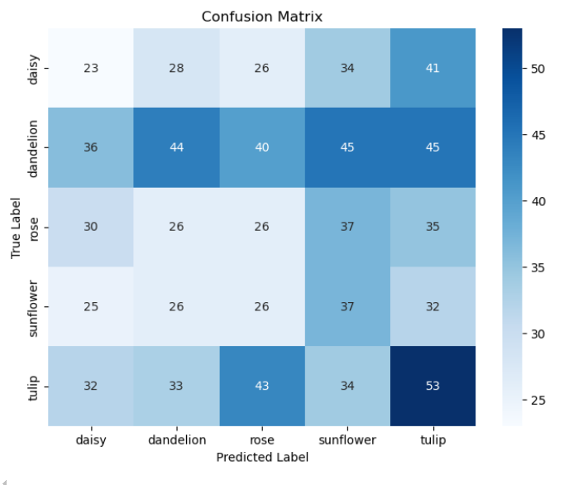
Flower Identification Model 4
Accuracy:
Initial Model: 63%
VGG16 Transfer Learning: 82%
InceptionV3 Transfer Learning: 84%
Architecture:
Utilized transfer learning with VGG16 and InceptionV3 models.
Included additional layers for classification and fine-tuning.
Training: Trained for 5 epochs with transfer learning approach.

Slide 17

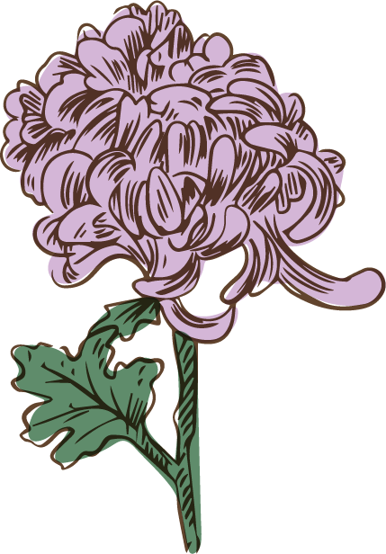




Model summary
Model 1 (Basic CNN Model):
Lowest accuracy among the four models.
Model 2 (Advanced Architecture with Batch Normalization and Data Augmentation):
Most advanced architecture. with longest training duration with 100 epochs.
Model 3 (Simpler Architecture):
Achieved moderate accuracy.
Model 4 (Transfer Learning with InceptionV3):
Accuracy: Highest accuracy of 84.25%.

Slide 18
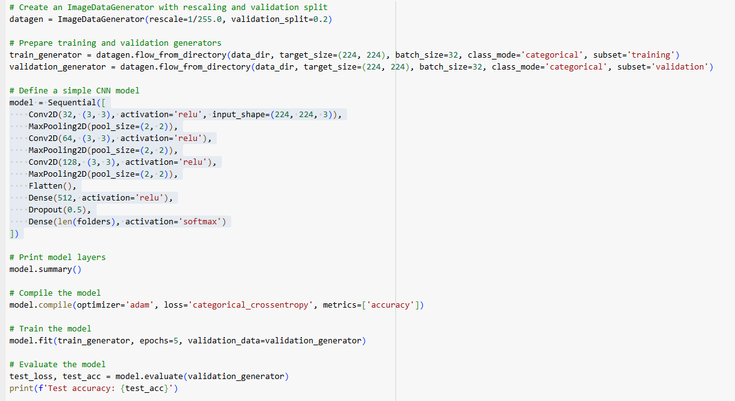
Image classification on a flower dataset using Convolutional Neural Networks (CNNs) and pre-trained models (VGG16 and InceptionV3)
Initial CNN model is built to classify images into different categories using convolutional layers for feature extraction, pooling layers for dimensionality reduction, and dense layers for classification, followed by training and evaluation to measure its performance

Slide 19
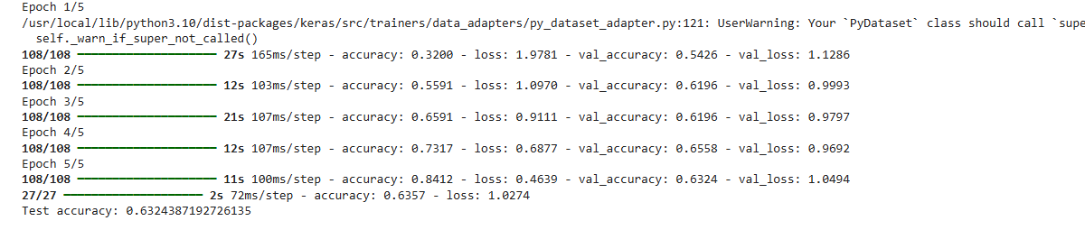
CNN Base Model - Training & Evaluation logs
Summary:
Training Performance: The training accuracy steadily improves from 32% to 84.12% over 5 epochs, while the training loss decreases, indicating the model is learning and fitting the training data better with each epoch.
Validation Performance: The validation accuracy improves initially and stabilizes around 63-65%, but there's a slight increase in validation loss by the end, indicating potential overfitting where the model performs well on training data but not as well on unseen data.
Test Performance: The test accuracy is 63.24%, showing the model's performance on a separate test dataset, which is consistent with the validation performance.
Overall, the model shows good improvement during training, with some signs of overfitting, suggesting the need for further optimising
Evaluation Logs:
27/27 ━━━━━━━━━━━━━━━━━━━━ 2s 72ms/step - accuracy: 0.6357 - loss: 1.0274:
accuracy: 0.6357: The test accuracy is 63.57%, indicating the model correctly predicts 63.57% of the test data.
loss: 1.0274: The test loss is 1.0274, showing how well the model fits the test data.

Slide 20
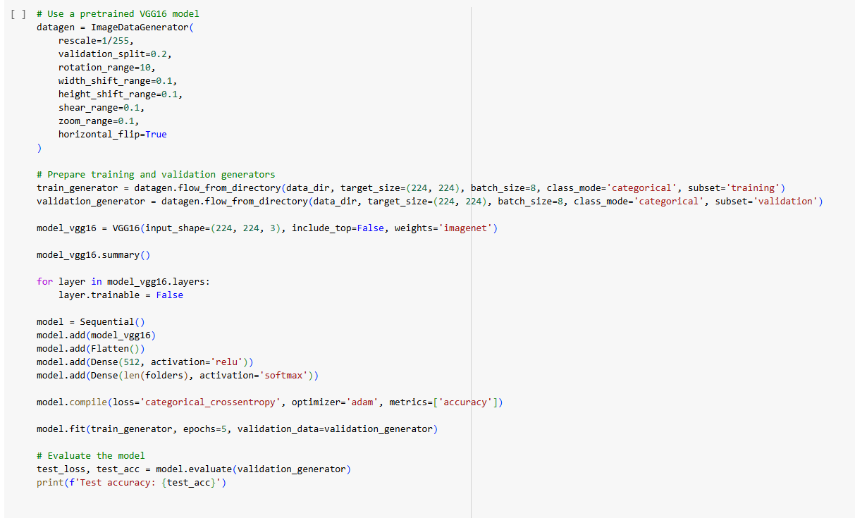
Pre-trained model- VGG16
The model consists of multiple convolutional layers with increased filters and max pooling layers to reduce spatial dimensions, culminating in a total of 14,714,688 parameters

Slide 21
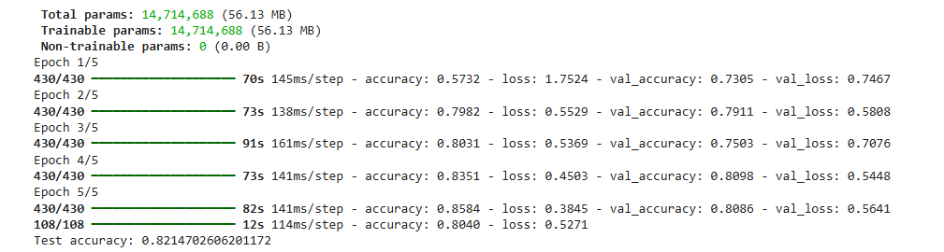
Pre-trained model- VGG16 - Training & Evaluation logs
Summary:
Training Performance: The training accuracy steadily improves from 57.32% to 85.84% over 5 epochs, while the training loss decreases, indicating the model is learning and fitting the training data better with each epoch.
Validation Performance: The validation accuracy starts at 73.05% and stabilizes around 80.86%, showing a general improvement. However, there is a slight increase in validation loss towards the end, indicating potential minor overfitting.
Test Performance: The test accuracy is 82.14%, which is consistent with the validation performance, indicating good generalization to unseen data.
Overall, the VGG16 model shows significant improvement during training and maintains strong performance on validation and test datasets, indicating effective learning and good generalization.
Evaluation Logs:
108/108 ━━━━━━━━━━━━━━━━━━━━ 12s 114ms/step - accuracy: 0.8040 - loss: 0.5271:
accuracy: 0.8040: The test accuracy is 80.40%, indicating the model correctly predicts 80.40% of the test data.
loss: 0.5271: The test loss is 0.5271, showing how well the model fits the test data.

Slide 22
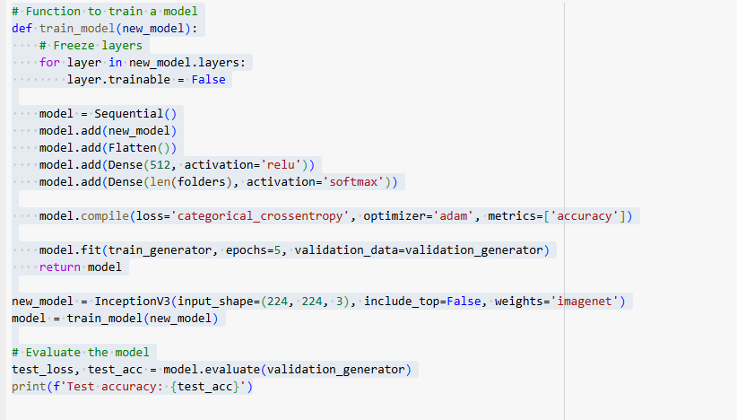
Pre-trained model- InceptionV3

Slide 23
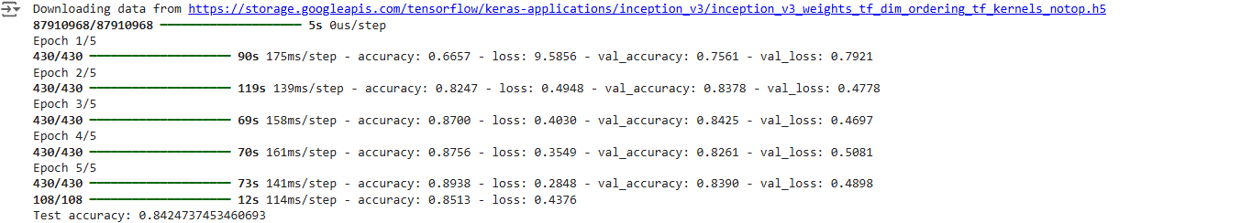
Pre-trained model- InceptionV3 - Training & Evaluation logs
Summary:
Training Performance: The training accuracy steadily increases from 66.57% to 89.38% over 5 epochs, while the training loss decreases, showing that the model is effectively learning and fitting the training data.
Validation Performance: Validation accuracy starts at 75.61% and fluctuates, ending at 83.90%. Validation loss shows a general decrease with some fluctuation, indicating occasional overfitting.
Test Performance: The test accuracy of 84.24% and a test loss of 0.4376 reflect strong performance, indicating good generalization to unseen data.
Overall, the InceptionV3 model demonstrates significant improvement in training accuracy and maintains strong performance on both validation and test datasets, indicating effective learning and good generalization.
Evaluation Logs:
accuracy: 0.8513: The test accuracy is 85.13%, indicating the model correctly predicts 85.13% of the test data.
loss: 0.4376: The test loss is 0.4376, showing how well the model fits the test data

Slide 24
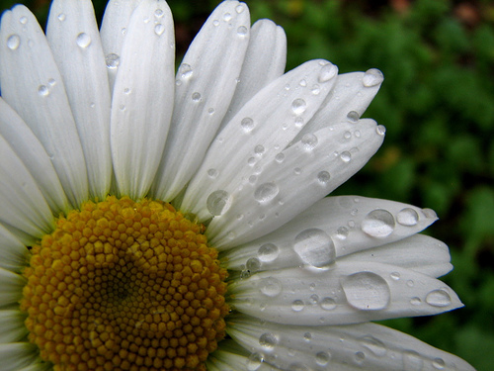

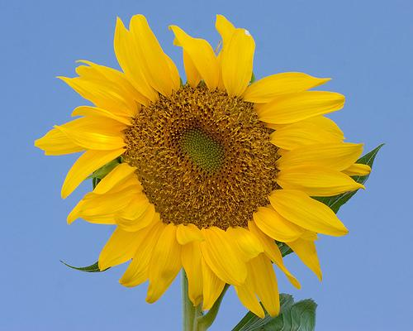

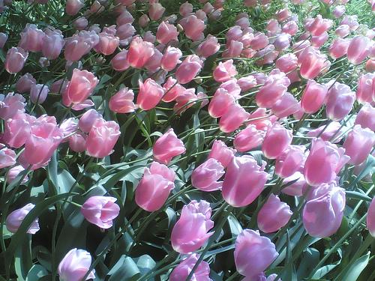
Model Evaluation: Which flower is that?
CNN
Daisy
Dandelion
Sunflower
Rose
Tulip
Notes:
Yash

Slide 25
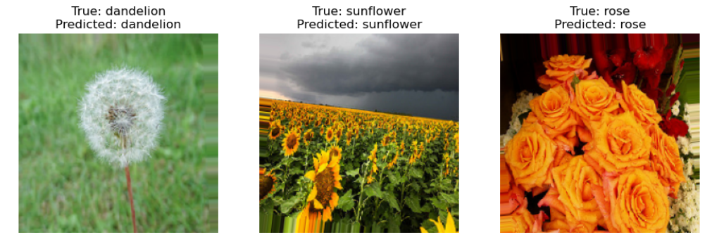
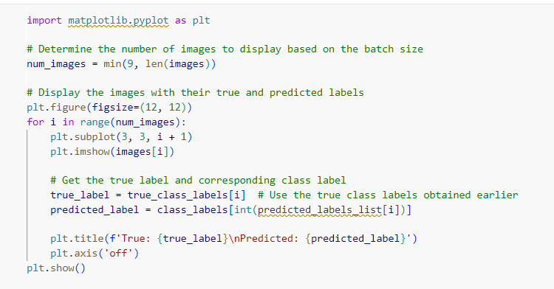
Making predictions using or CNN model/s
Our trained model could predict certain classes better than others.

Slide 26
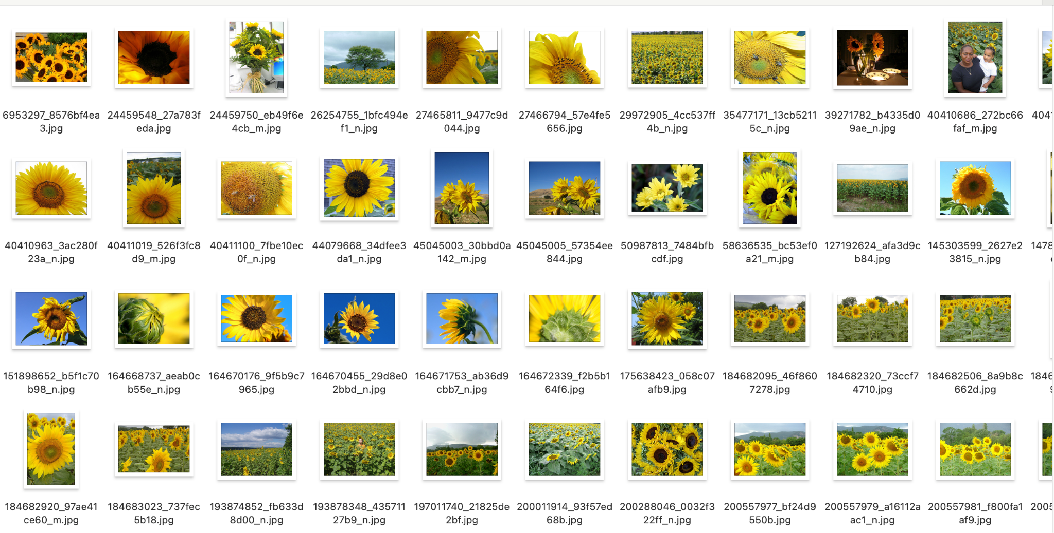
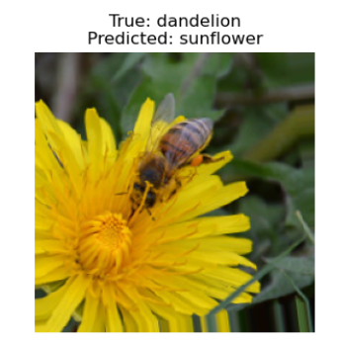
Although our trained model had an accuracy of 84% our model is still prone to making errors, most commonly in the flowers that have similar attributes.
For example a yellow dandelion and a sunflower have very similar characteristics of long yellow petals and a compacted bloom at the centre.
glimpse of the sunflower dataset

Slide 27
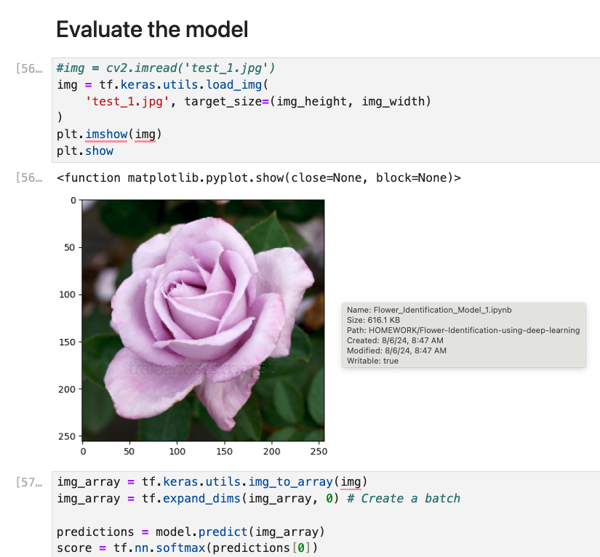
Check with “unseen” data

Slide 28
Learnings
Opportunities for Improvement
Working with image data = no dataframe!
New activation function ‘softmax’ and loss function ‘sparse categorical entropy’
Tensorflow’s dataset pipelines make image classification a lot easier
Validation accuracy scores are still low. Data overfits. Model has probably considered the noise during learning process
Explore data augmentation techniques: generate additional data from existing training data
Using the dropout technique
Convert images to grayscale
Notes:
Caveat - flower identification

Slide 29
Thank You

